Slide 1
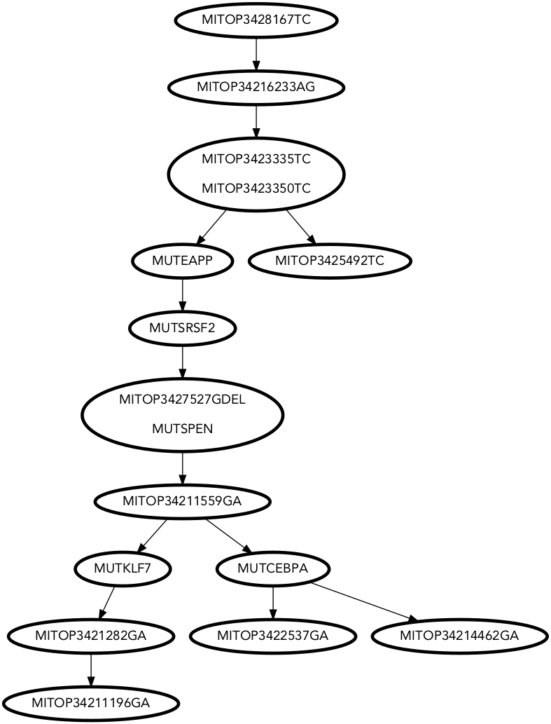
Patient P342 – SRSF2 mutant
⦁ ^{Mutant}
⦁ ^{Reference}
⦁ ^{Dropout}
Lots of clonal heterogeneity
Mutations in SRSF2, CEBPA, KLF7

Slide 2
P342 – SRSF2 mutant
What we know is true (validated by DNA-seq of single cell derived colonies):
SRSF2 + EAPP mutations came before CEBPA and KLF7
CEBPA and KLF7 mutations (green arrows) belong to distinct clones
What we think is true
The MITOP342 5492T>C mutation (red arrow) is a distinct clone from SRSF2 – because it is specific to T-cells
The clone carrying the SRSF2 mutation should not or very rarely produce T cells

Slide 3
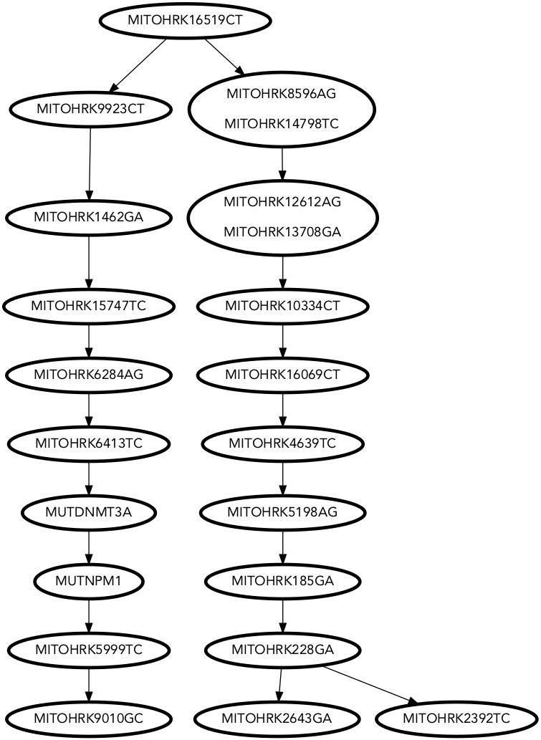
Patient HRK – NPM1
⦁ ^{Mutant}
⦁ ^{Reference}
⦁ ^{Dropout}
NPM1
mutation →
NPM1 is a subclone of the myelopoietic clone

Slide 4
Patient HRK – NPM1
What we think is true
The DNMT3A mutation most likely occurred before the NPM1 mutation, but this effect may be impossible to see in the data.
I do think that there are NPM1 wild type cells in the clone of the left arm. Possibly the NPM1 mutation is not present in cells of type ‘MEP’ and ‘HSC’.
B cells should mostly derive from the clone of the right arm
NPM1
mutation →

